Slide 1
CAR ACCIDENT DETECTOR & INFORMER
“Changes call for innovation,
and innovation leads to progress.”
TEAM : CODE RIDERS
BY: Shubham singh
Jahanvi Sharma
Vaibhav singh

Slide 2
PURPOSE
This device is for the automation of accident detection and notifying the hospitals, police stations about the accident data.
Intended Audience and Reading Suggestions
This project is for the Accident detection and targets car manufacturing industry for implementation and is restricted to the accident suspect.

Slide 3
PROJECT SCOPE
The proposed device is for accident notification system (A.N.S). This product will be used in vehicles to get the data of accident and further notifying police station and hospitals.
Goal: It will reduce the no of deaths in accident cases and will help to track data of car .Including, will help to solve various cases of road accident and will able to find the culprit.

Slide 4
Overall Description
Product Perspective
Currently we don't have any system to send notification to Hospitals and police station.
There are few more systems which can be integrated with this system to make it more flexible:
1. Voice enabled first aid instruction system.
2. Air-bagged system.

Slide 5
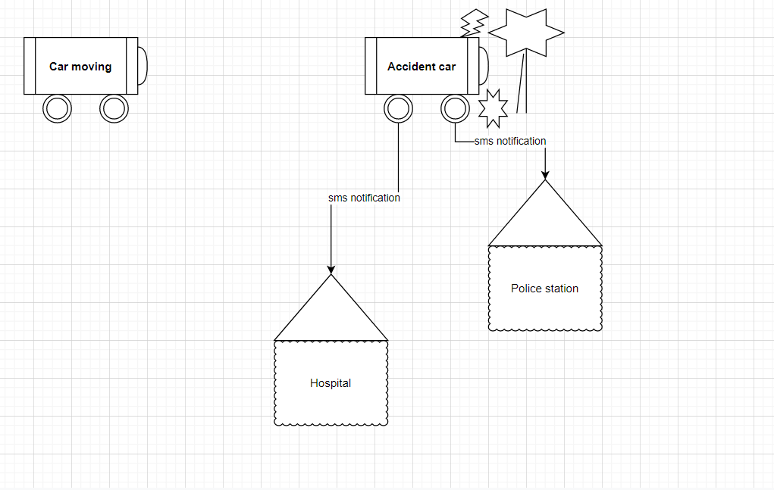
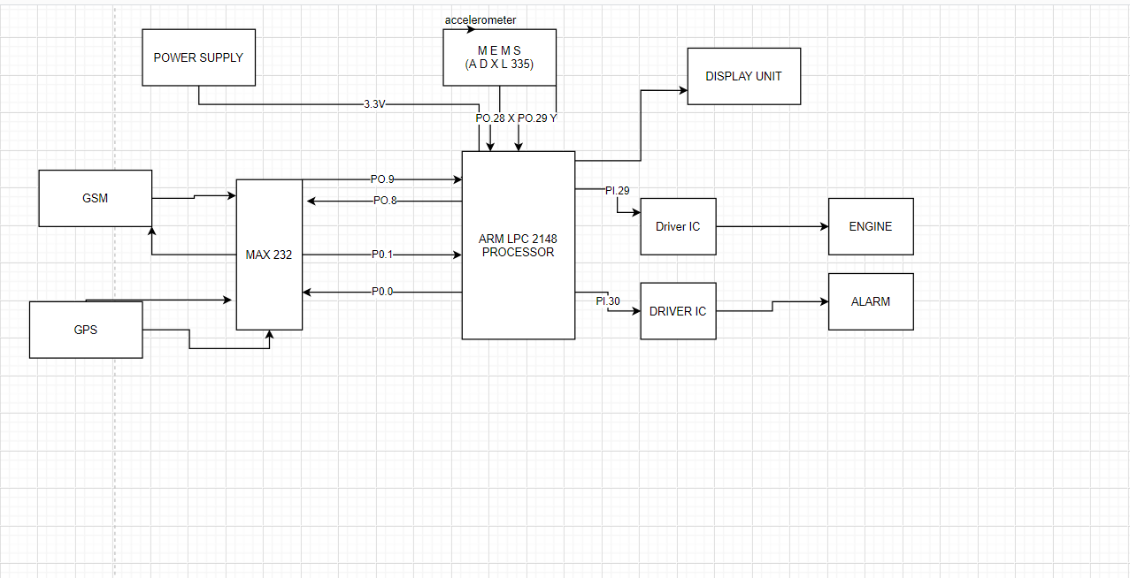
Product Features

Slide 6
User Classes and Characteristics
USER:-The user or driver with co -passenger can get emergency help in case of accident.
Police station: Can get notification about the accident and track device using gps tracker.
Hospital: Hospital can provide instant emergency support in case of accident to the victim.
Family: can be notified about the damage.

Slide 7
Operating Environment
All BDS Engines.
All vehicles with global positioning system enabled.
All vehicles with Air bag system enabled.
Design and Implementation Constraints.
Enabling system with the Old cars.
Adaptability of current market.
Cost effective ways.
Assumptions and Dependencies
Let us assume that this is a distributed Accident detection system and it is used in the following application:
Application to track vehicle.
Application to Detect location of vehicle met accident.

Slide 8
System Features
Description and priority:
The accident notification System notifies or informs about the accident spot , time to the nearby hospital , police station and family members .Of course, this project has very high priority in order because will save life in road accident .
Stimulus/Response Sequences
Accident will be detected by accelerometer.
Engine stops.
Alarm starts.
Gsm model activates and send notification.
External Interface Requirement
User Interface :
Car Driver with car
Hardware interface :
Power supply with processor
Accelerometer with processor
Gsm with Processor as input and output.
Gps with processor as input and output and device tracker .
Display unit for output from processor.

Slide 11
THANK YOU ☺
ANY QUESTIONS ???

